Slide 1
Robust Robotic Grasping Utilising Touch Sensing
Justin Koo

Slide 2
Progress
Baseline approach (implementation & results) for deciding on the best representation for tactile data (sensor readings) and visual data (end effector poses)
Combinations of data: (tactile only, visual only, tactile + visual)
Add table later
Naïve learning policy (infers hand poses and determines if a pose is good or bad from geometric, tactile and visual data)

Slide 3
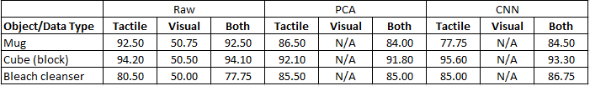
Baseline results
Epochs=1000, learning rate=1e-5
For only visual data, LR model predicts the same class for all test samples -> overfitted(?)
Tactile + visual performs the best
CNN performs the best overall

Slide 4
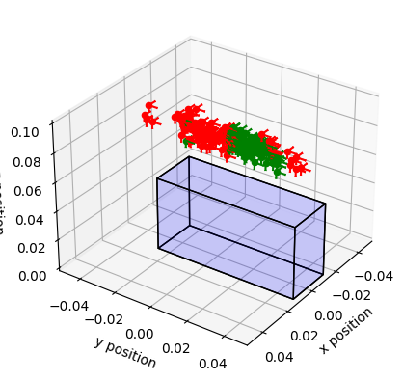
Decision boundary visualisation

Slide 5
Progress
Baseline approach (implementation & results) for deciding on the best representation for tactile data (sensor readings) and visual data (end effector poses)
Combinations of data: (tactile only, visual only, tactile + visual)
Add table later
Naïve learning policy (infers hand poses and determines if a pose is good or bad from geometric, tactile and visual data)

